Slide 1
TRAVALLER’S HUB
Name : SOORAJ.M
Reg NO :MES20MCA2052
Product Owner : Ms.Febin Aziz

Slide 2
TABLE OF CONTENTS
Introduction
Modules
Methodology
Future Enhancements
Developing Environment
Product Backlog
User Stories
Project Plan
Sprint Plan
Sprint Actual

Slide 3
TRAVELLER’S HUB
Here we introduce a social media platform for those who love travel. This web application allows users to create a room for discussion and planning for the trip to a particular destination, if any other user is also interested and planning for the same destination, then that person can join in this room. This platform brings a new way of connecting new people of our mentality. In this web application, the user should specify their way of transport which distinguishes them from others, and show only those rooms with the same transportation system.
This web application will allow users to connect with new people of their kind of mentality. Through this system we can reduce our effort through our trip, as we move in the group which will have all members of that room, things become easy to manage and overcome difficulties.

Slide 4
MODULES
USER (Admin Of the Room)
Register
Login
Create Room
View Request
Manage Request
Chat
Share Content
View content
Delete Room
Remove Members
USER (Member of the Room)
Register
Login
Search Room
Send Request
View Request Response
Chat
Share Content
View Content
Exit Room

Slide 5
METHODOLOGY
Traveller’s Hub is a social media platform for those who love travel. This web application allows users to create a room for discussion and planning for the trip to a particular destination on the basis of their interested vehicle .Any other user who interested can join in this room. This platform brings a new way of connecting new people of our mentality. In this web application, the user should specify their way of transport which distinguishes them from others, and show only those rooms with the same transportation system.
This web application will allow users to connect with new people of their kind of mentality. Through this system we can reduce our effort through our trip, as we move in the group which will have all members of that room, things become easy to manage and overcome difficulties.
The system mainly consist of two module which is a normal user and a user with admin privilege .
The user(admin) is the one who creates the room and the normal user is the one who joins the room . The user(admin) will manage the request send by the normal user. Every one in the system can create their own rooms and can join in the room which is founded by searching on the basis of destination.The rooms can be deleted by the creators and also he/she is able to manage the member count. The members can exit from the room whenever they want.Both of them can communicate by sharing media in the chat box.

Slide 6
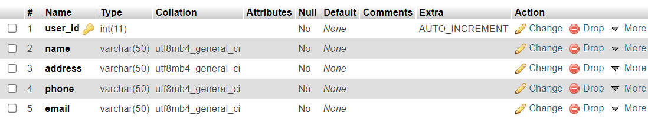
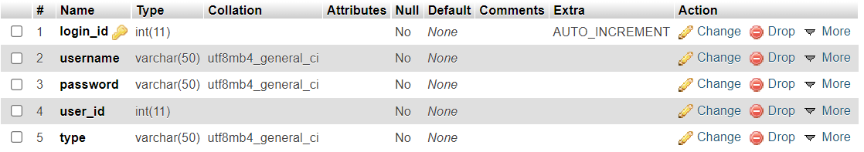
Tables
USER REGISTRATION
LOGIN

Slide 7
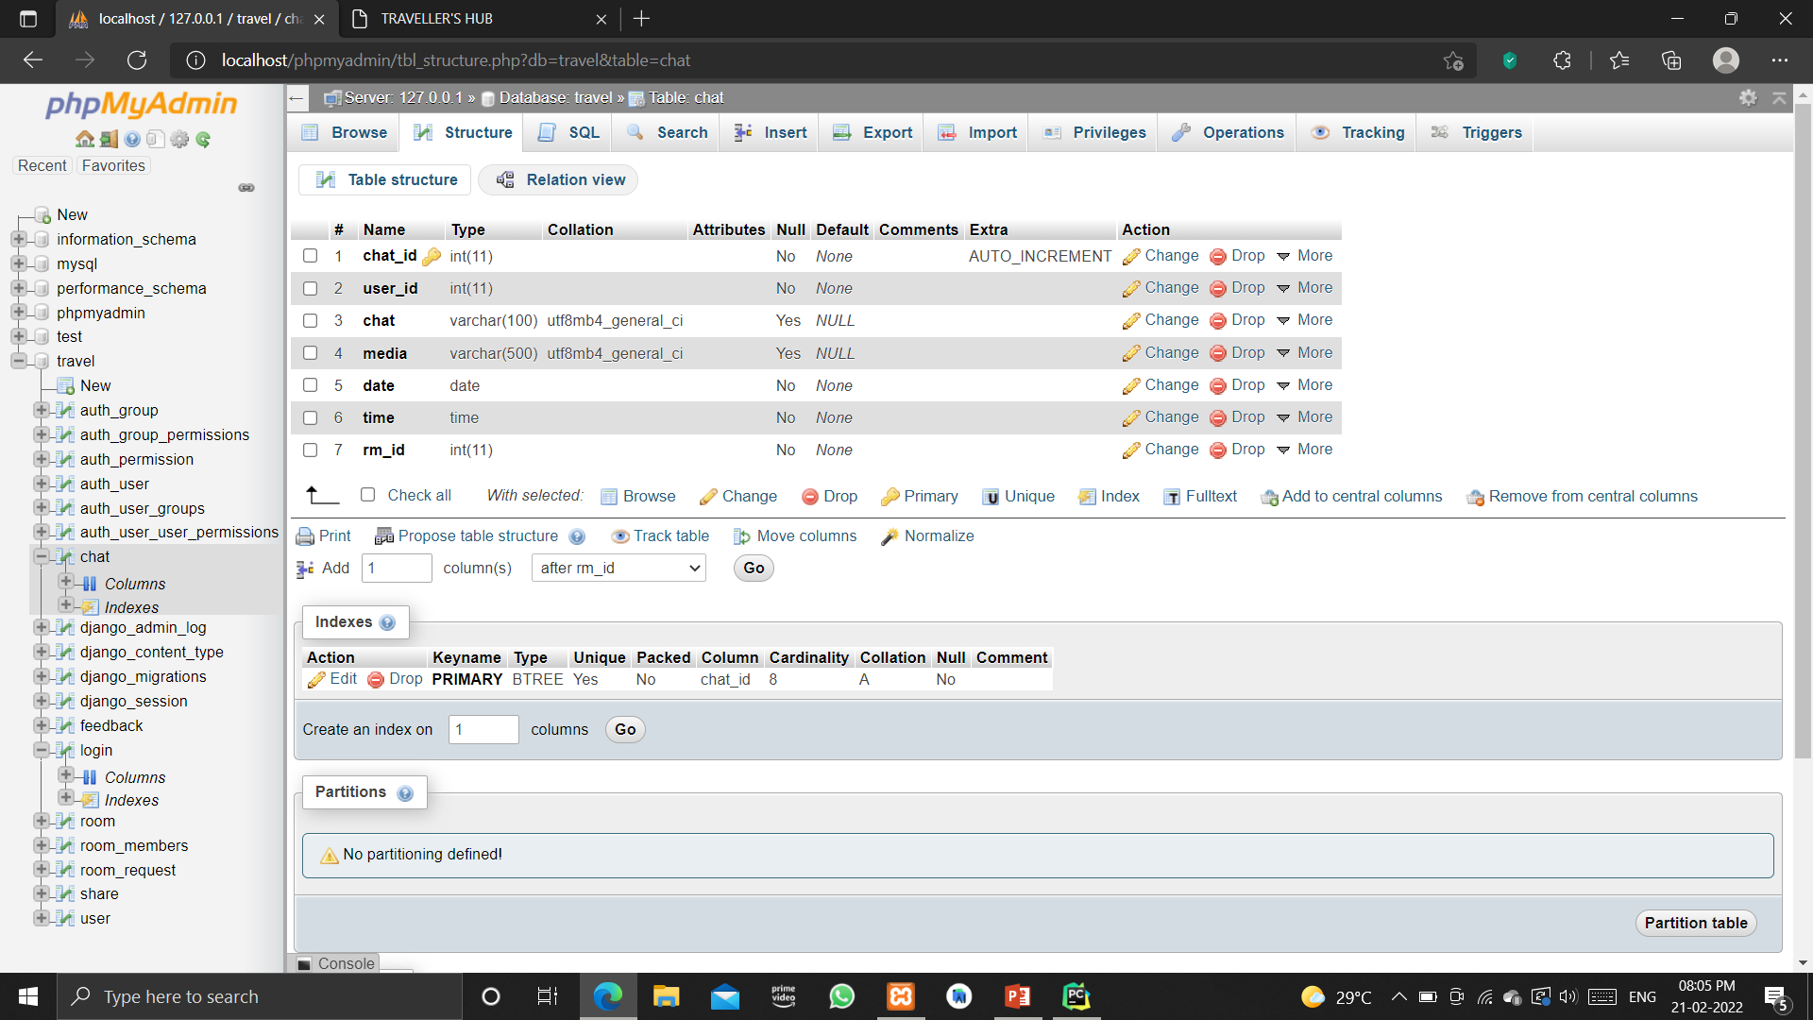
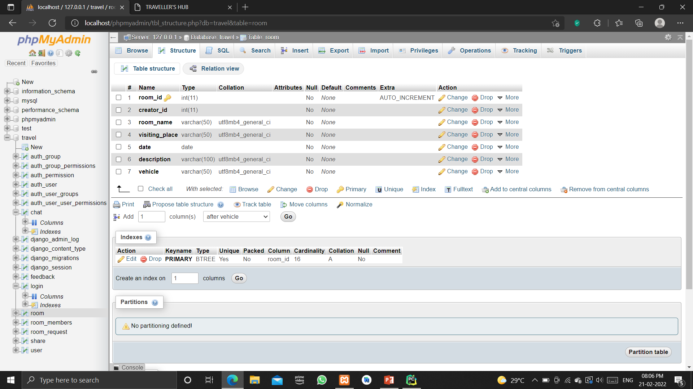
CHAT
ROOM

Slide 8
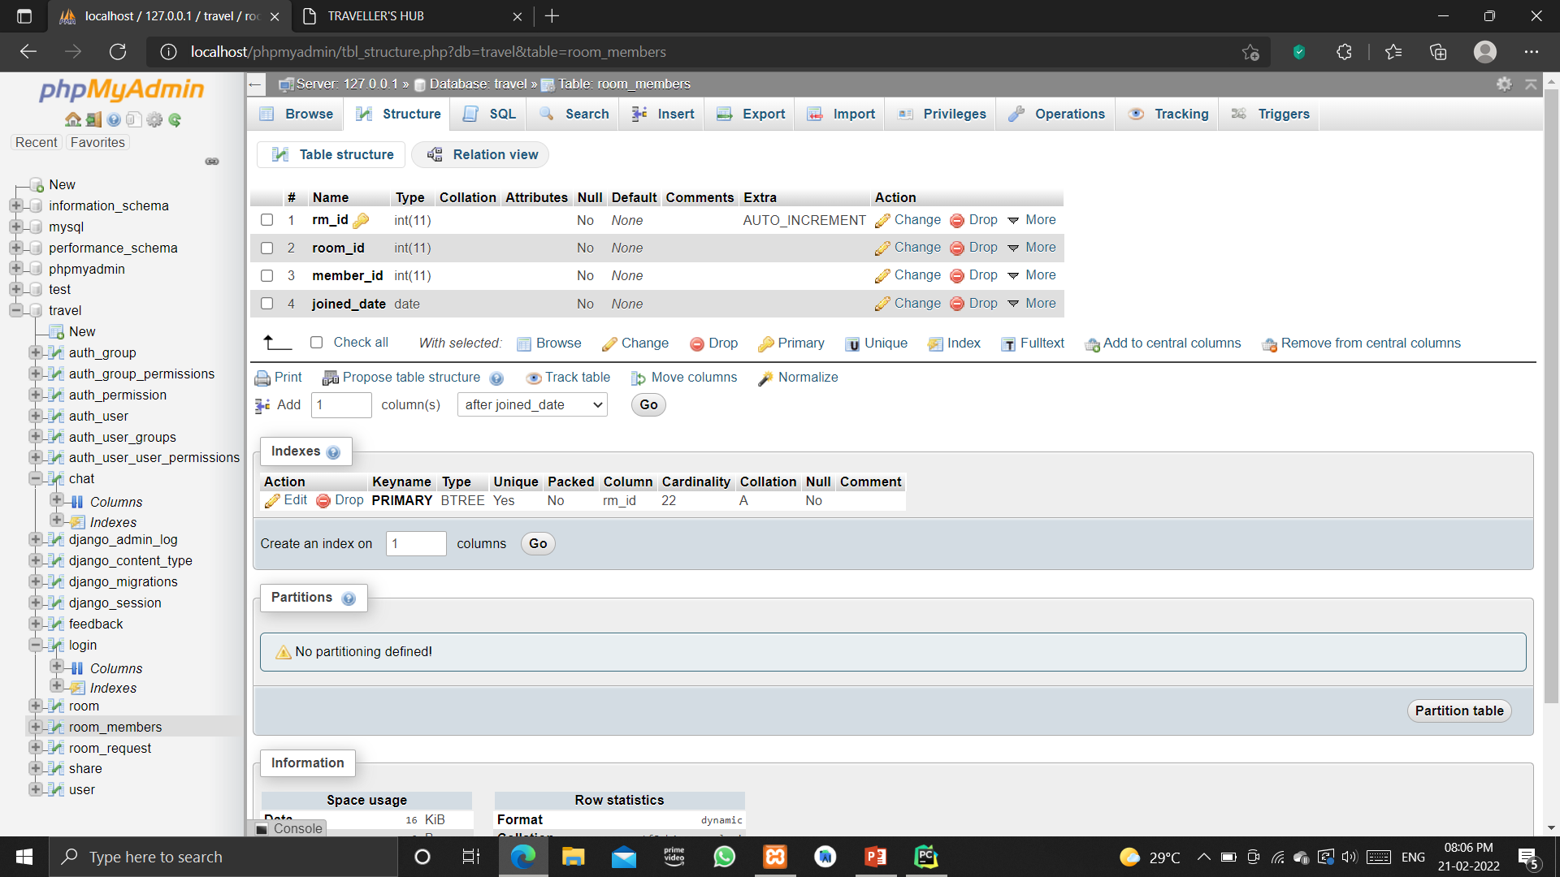
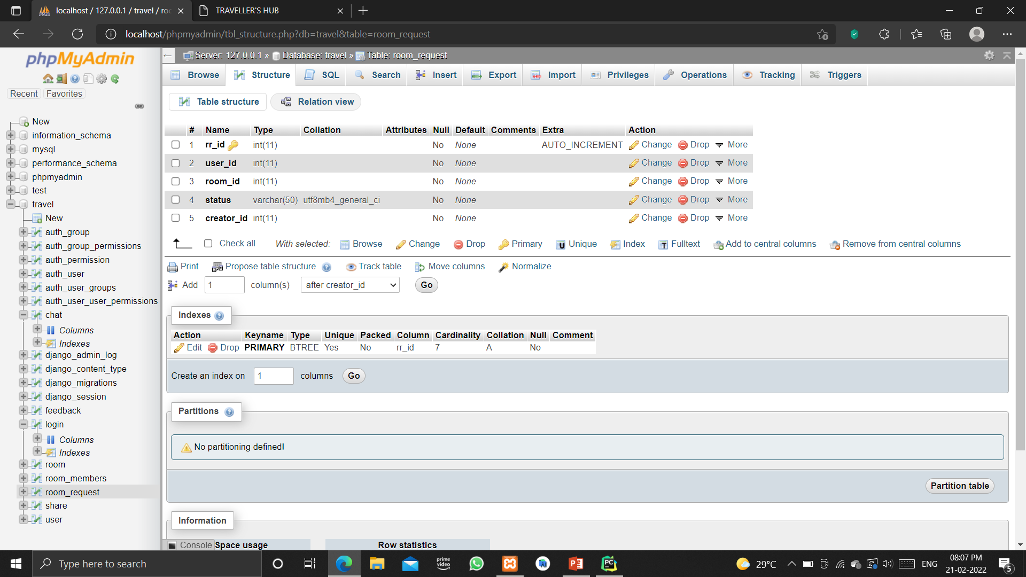
ROOM MEMBERS
ROOM REQUEST

Slide 9
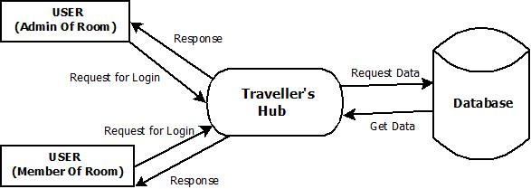
DATA FLOW DIAGRAM
LEVEL 0

Slide 10
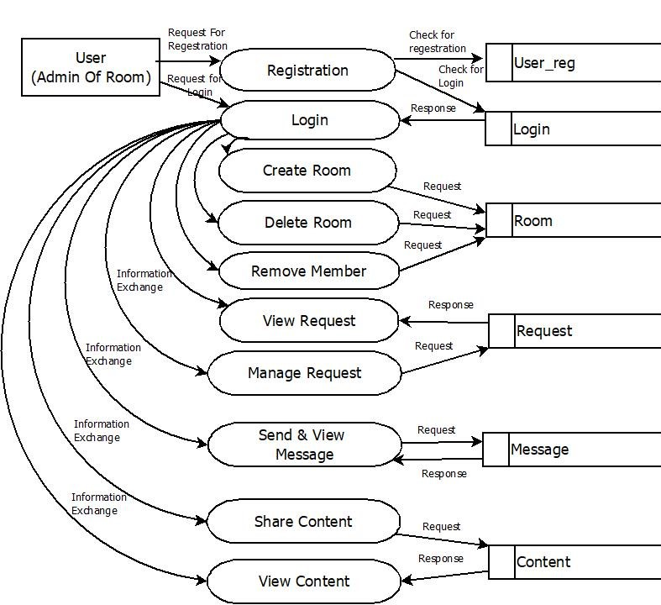
DATA FLOW DIAGRAM
LEVEL 1

Slide 11
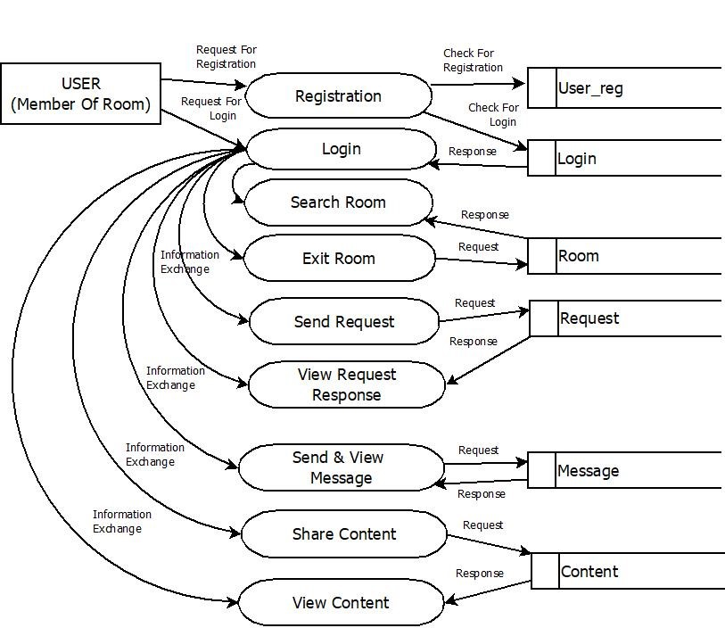
DATA FLOW DIAGRAM
LEVEL 2

Slide 12
FUTURE ENHANCEMENT
The project has a very vast scope in future . Various functionalities can be added to this system.
We can add accommodation details, like hotel name , facilities , location , charges , of the destination.
Merge various rooms with same destination.
Predict the best medium for travel.
Give a detailed view on selected destination on the basis of culture.
Suggest the destination on the basis of selected activities or taste.

Slide 13
DEVELOPING ENVIRONMENT
Front-End : HTML,CSS Java Script
Back-End : Python , Django
Database : Mysql
IDE : Pycharm
Operating System : Windows 10
Processor : Intel Core i5
RAM : 8 GB

Slide 14
PROJECT PLAN
User Story ID | Task Name | Start Date | End Date | Days | Status
1 | Sprint 1 | 15/11/2021 | 17/11/2021 | 5 | Completed
2 |  | 17/11/2021 | 19/11/2021 |  | Completed
3 | Sprint 2 | 22/11/2021 | 24/11/2021 | 8 | Completed
4 |  | 24/11/2021 | 29/11/2021 |  | Completed
5 | Sprint 3 | 01/11/2021 | 06/11/2022 | 20 | Completed
6 |  | 13/12/2021 | 16/12/2021 |  | Completed
7 |  | 03/01/2022 | 06/01/2022 |  | Completed
8 | Sprint 4 | 17/01/2022 | 20/01/2022 | 10 | Completed
9 |  | 07/01/2022 | 09/01/2022 |  | Completed
10 |  | 14/02/2022 | 16/02/2022 |  | Completed

Slide 15
USER STORY
User Story ID | As a<type of user> | I want to <perform some task> | So that I can <achieve some goal>
1 | User | Registration | Access Login
2 | User | Login | Access Home Page
3 | User | Select Vehicle & Destination | Create Room As Admin
4 | User | Search Room | Send Request
5 | User | Manage Request | Reject/Accept Request
6 | User | Add Details | Share with Members
7 | User | Send Message | Communicate with other Members
8 | User | Delete Room | Exit Room
9 | User | Remove Member | Manage Member Count
10 | User | Remove Room | Make It No More Available

Slide 16
PRODUCT BACKLOG
User Story ID | Priority <High/Medium/Low> | Size (Hours) | Sprint <#> | Status <Planned/In Progress/Completed> | Release Date | Release Goal
1 | Medium | 5 | 1 | Completed | 17/11/2021 | Creation Of Registration Page
2 | Medium | 5 |  | Completed | 19/11/2021 | Creation Of Login Page
3 | High | 5 | 2 | Completed | 24/11/2021 | Create Room
4 | High | 5 |  | Completed | 29/11/2021 | Requesting to Join Room
5 | High | 5 | 3 | Completed | 06/12/2021 | Accessing Room
6 | Medium | 5 |  | Completed | 16/12/2021 | Content Sharing
7 | Medium | 5 |  | Completed | 06/01/2022 | Communication Among User
8 | Medium | 5 | 4 | Completed | 20/01/2022 | Leave Room
9 | Medium | 5 |  | Completed | 09/02/2022 | Remove Member
10 | High | 5 |  | Completed | 16/02/2022 | Remove Room

Slide 17
SPRINT BACKLOG PLAN
Backlog Item | Status and Completion date | Original Estimate in hours | Day 1 | Day 2 | Day 3 | Day 4 | Day 5 | Day 6 | Day 7 | Day 8 | Day 9 | Day 10 | Day 11 | Day 12 | Day 13
User story #1,2 |  |  | Hours | Hours | Hours | Hours | Hours | Hours | Hours | Hours | Hours | Hours | Hours | Hours | Hours
UI Designing | 17/11/21 | 2 | 2 | 0 | 0 | 0 | 0 | 0 | 0 | 0 | 0 | 0 | 0 | 0 | 0
Database Connectivity | 19/11/21 | 2 | 0 | 2 | 0 | 0 | 0 | 0 | 0 | 0 | 0 | 0 | 0 | 0 | 0
Coding | 19/11/21 | 2 | 0 | 2 | 0 | 0 | 0 | 0 | 0 | 0 | 0 | 0 | 0 | 0 | 0
Testing | 19/11/21 | 2 | 0 | 2 | 0 | 0 | 0 | 0 | 0 | 0 | 0 | 0 | 0 | 0 | 0
User story #3,4
UI Designing | 24/11/21 | 5 | 0 | 0 | 5 | 0 | 0 | 0 | 0 | 0 | 0 | 0 | 0 | 0 | 0
Database Connectivity | 29/11/21 | 3 | 0 | 0 | 0 | 3 | 0 | 0 | 0 | 0 | 0 | 0 | 0 | 0 | 0
Coding | 29/11/21 | 6 | 0 | 0 | 0 | 0 | 6 | 0 | 0 | 0 | 0 | 0 | 0 | 0 | 0
Testing | 29/11/21 | 4 | 0 | 0 | 0 | 0 | 4 | 0 | 0 | 0 | 0 | 0 | 0 | 0 | 0
User story #5,6,7
UI Designing | 03/01/22 | 4 | 0 | 0 | 0 | 0 | 0 | 4 | 0 | 0 | 0 | 0 | 0 | 0 | 0
Database Connectivity | 06/01/22 | 3 | 0 | 0 | 0 | 0 | 0 | 3 | 0 | 0 | 0 | 0 | 0 | 0 | 0
Coding | 06/01/22 | 3 | 0 | 0 | 0 | 0 | 0 | 0 | 3 | 0 | 0 | 0 | 0 | 0 | 0
Testing | 06/01/22 | 2 | 0 | 0 | 0 | 0 | 0 | 0 | 0 | 2 | 0 | 0 | 0 | 0 | 0
User story #8,9,10
UI Designing | 14/02/22 | 4 | 0 | 0 | 0 | 0 | 0 | 0 | 0 | 0 | 4 | 0 | 0 | 0 | 0
Database Connectivity | 16/02/22 | 2 | 0 | 0 | 0 | 0 | 0 | 0 | 0 | 0 | 0 | 2 | 0 | 0 | 0
Coding | 16/02/22 | 3 | 0 | 0 | 0 | 0 | 0 | 0 | 0 | 0 | 0 | 0 | 3 | 0 | 0
Testing | 16/02/22 | 3 | 0 | 0 | 0 | 0 | 0 | 0 | 0 | 0 | 0 | 0 | 3 | 0 | 0
Total |  | 50 | 2 | 6 | 5 | 3 | 10 | 7 | 3 | 2 | 4 | 2 | 6 | 0 | 0

Slide 18
SPRINT BACKLOG ACTUAL
Backlog Item | Status and Completion date | Original Estimate in hours | Day 1 | Day 2 | Day 3 | Day 4 | Day 5 | Day 6 | Day 7 | Day 8 | Day 9 | Day 10 | Day 11 | Day 12 | Day 13 | Completed <Y/N>
User story #1,2 |  |  | Hours | Hours | Hours | Hours | Hours | Hours | Hours | Hours | Hours | Hours | Hours | Hours | Hours
UI Designing | 17/11/21 | 2 | 2 | 0 | 0 | 0 | 0 | 0 | 0 | 0 | 0 | 0 | 0 | 0 | 0 | Y
Database Connectivity | 19/11/21 | 2 | 0 | 2 | 0 | 0 | 0 | 0 | 0 | 0 | 0 | 0 | 0 | 0 | 0 | Y
Coding | 19/11/21 | 2 | 0 | 2 | 0 | 0 | 0 | 0 | 0 | 0 | 0 | 0 | 0 | 0 | 0 | Y
Testing | 19/11/21 | 2 | 0 | 2 | 0 | 0 | 0 | 0 | 0 | 0 | 0 | 0 | 0 | 0 | 0 | Y
User story #3,4
UI Designing | 24/11/21 | 5 | 0 | 0 | 5 | 0 | 0 | 0 | 0 | 0 | 0 | 0 | 0 | 0 | 0 | Y
Database Connectivity | 29/11/21 | 3 | 0 | 0 | 0 | 3 | 0 | 0 | 0 | 0 | 0 | 0 | 0 | 0 | 0 | Y
Coding | 29/12/21 | 6 | 0 | 0 | 0 | 0 | 6 | 0 | 0 | 0 | 0 | 0 | 0 | 0 | 0 | Y
Testing | 29/12/21 | 4 | 0 | 0 | 0 | 0 | 4 | 0 | 0 | 0 | 0 | 0 | 0 | 0 | 0 | Y
User story #5,6,7
UI Designing | 03/06/22 | 4 | 0 | 0 | 0 | 0 | 0 | 4 | 0 | 0 | 0 | 0 | 0 | 0 | 0 | Y
Database Connectivity | 06/01/22 | 3 | 0 | 0 | 0 | 0 | 0 | 3 | 0 | 0 | 0 | 0 | 0 | 0 | 0 | Y
Coding | 06/01/22 | 3 | 0 | 0 | 0 | 0 | 0 | 0 | 3 | 0 | 0 | 0 | 0 | 0 | 0 | Y
Testing | 06/01/22 | 2 | 0 | 0 | 0 | 0 | 0 | 0 | 0 | 2 | 0 | 0 | 0 | 0 | 0 | Y
User story #8,9,10
UI Designing | 14/02/22 | 4 | 0 | 0 | 0 | 0 | 0 | 0 | 0 | 0 | 4 | 0 | 0 | 0 | 0 | Y
Database Connectivity | 16/02/22 | 2 | 0 | 0 | 0 | 0 | 0 | 0 | 0 | 0 | 0 | 2 | 0 | 0 | 0 | Y
Coding | 16/02/22 | 3 | 0 | 0 | 0 | 0 | 0 | 0 | 0 | 0 | 0 | 0 | 3 | 0 | 0 | Y
Testing | 16/02/22 | 3 | 0 | 0 | 0 | 0 | 0 | 0 | 0 | 0 | 0 | 0 | 3 | 0 | 0 | Y
Total |  | 50 | 2 | 6 | 5 | 3 | 10 | 7 | 3 | 2 | 4 | 2 | 6 | 0 | 0 | Y

